Slide 1

Annual Report
Fiscal Year 2026

Slide 2
Table of contentS
Dukes County Health and Human Services Mission
DCHHS Programs:
Health Care Access
Public Benefits Access
Emergency Financial Assistance
Vineyard Smiles
Program Updates
Funding
Program and Staff Information

Slide 3

Direct Client Services Additional Support Services
    Health Care Access - Vineyard Smiles Dental Program
    Public Benefits Access - Emergency Financial Assistance
assists residents to access and obtain affordable, high-quality health-related services, PUBLIC BENEFITS and support, particularly lower-income Dukes County residents, with the goal of assisting them to achieve and maintain financial stability and social well-being.

Slide 4
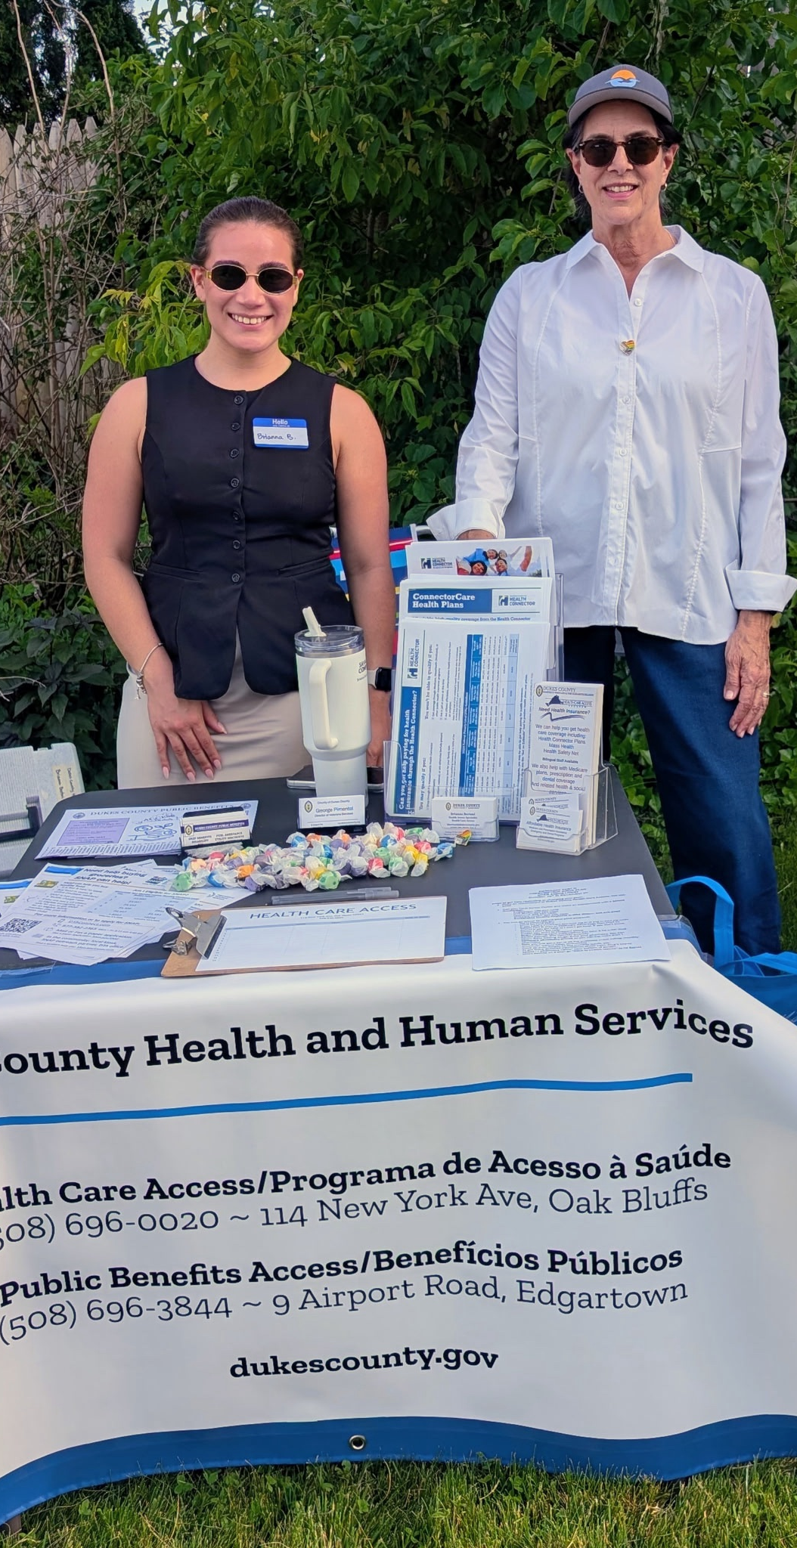


Connects island residents with Massachusetts’ affordable health insurance plans and helps retain coverage.
The Health Care Access is a grantee of the MA Health Connector’s Navigator Program (required by the Affordable Care Act).

Slide 5
What are the services?
  Health insurance application, enrollment and retention assistance
  Information, referral and advocacy
  Referral to medical providers
  Resources to aid medical debt
  Access to medical care: dental, vision, prescription medication
  Senior Assistance Program – applications, benefits counseling, program navigation
How does HCA staff accomplish these services?
  Health Access Specialists participates in extensive training and pass recertification exams to keep HC Navigator status and SHINE certificate.

Slide 6

FY2026 in client numbers:
4,253 individuals of all ages connected with affordable insurance programs though MassHealth and Health Connector application and enrollment assistance
680 seniors were assisted with Medicare, Medicare Part D and Prescription Advantage; MassHealth Long Term Care & Frail Elder Waiver programs
7,100 times the HCA staff assisted clients access health insurance coverage for medical, dental and prescription expenses and other related referral assistance

Slide 7
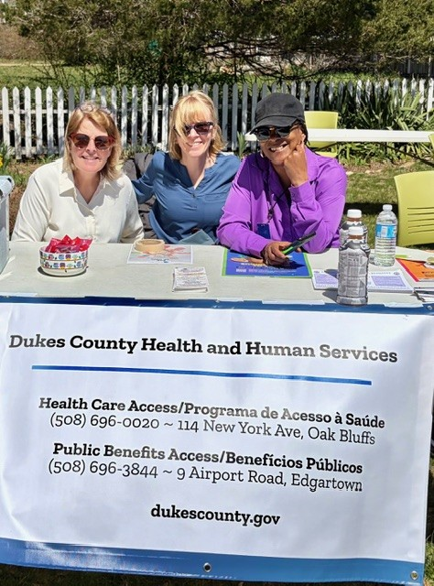

Mission Statement:
Provides access to programs that support and empower lower-income residents of the County to achieve and maintain financial stability and well-being.

Slide 8

PBA Caseworker assists Islanders apply for public benefits.
Depart of Unemployment Assistance (DUA)
Department of Transitional Assistance (DTA)
  Cash Assistance
    EAEDC – Emergency Aid to Elderly, Disabled, and Children
    TAFDC – Transitional Aid to Families with Dependent Children
  Food Assistance
    Supplemental Nutrition Assistance Program (SNAP)
    WIC
Fuel Assistance – winter heating help through Southshore Community Action Council, Inc.

Slide 9
PBA Caseworker assists Islanders apply for public benefits.
Housing Assistance
    Housing Assistance Corporation (HAC) Intake Forms
      RAFT – Residential Assistance for Families in Transition
      ERMA – Emergency Rental and Mortgage Assistance
      Private Homeless Prevention Programs and Funding
      Workforce Release Fund
    Island Elderly Housing (IEH) Applications
    Morgan Woods Affordable Housing Units Applications
Social Security Disability and Social Security Retirement

Slide 10

FY2026 in numbers:
517 applications submitted for individuals of all ages for SNAP, Fuel Assistance, Unemployment benefits, housing, and cash assistance programs, and utility company discounts.
781 times PBA provided assistance to access food, housing, and help with fuel and utility bills

Slide 11
Emergency Financial Assistance
Provides help with medical-related expenses to Islanders to afford prescription medication, medical supplies, grocery store gift cards, annual bus passes, and other emergency assistance
In FY2026 HCA and PBA provided $9,432 in financial assistance!
Fund donors: Elizabeth and Peter Tower Foundation; the United Methodist Church, individual donors, and local businesses

Slide 12
Vineyard Smiles
Dukes County’s oral health initiative, established in 2005
In collaboration with Polished Teeth Dental Hygiene Program
Local supporters:
Martha’s Vineyard Community Foundation
Towns’ Boards of Health
In February 2026, VS provided dental hygiene visits to 206 low-income adult patients in the midst of a winter blizzard at
  Island Elderly Housing
  local Councils on Aging

Slide 13
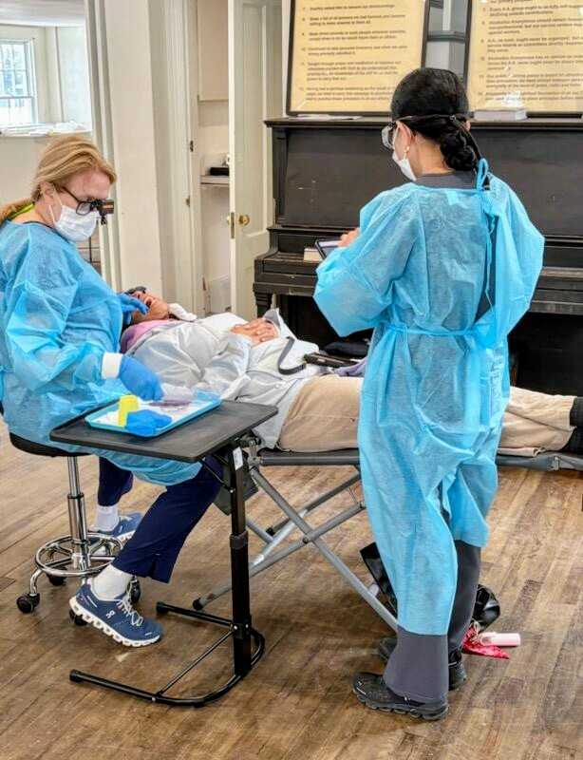
Vineyard Smiles Highlights:
  Many of these adult patients had not seen dental professional in over 10 years
  Only 10% reported having a local dentist
  13% had untreated decay and related periodontal disease

Slide 14

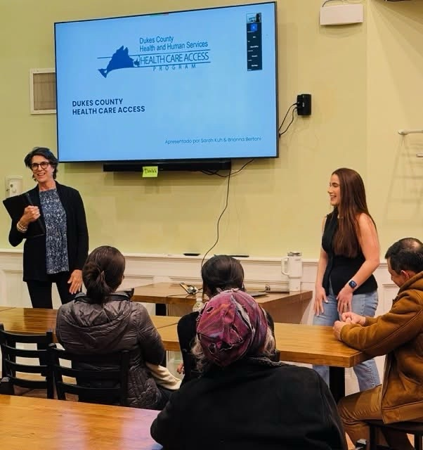
2026 program updates
  Changes in federal regulations had a significant impact on HCA programs and clients.
  Affordable Care Act subsidies expired at the end of 2025, which
    decreased availability of financial assistance for health insurance premiums for individuals and families starting in 2026
    certain categories of enrolled members lost their eligibility for insurance, resulting in higher rates of uninsurance in MA, including Dukes County.

Slide 15


2026 program updates
  HCA increased cross-training staff in
  2 public health insurance systems
    Health Connector system - MassHealth & health plans for 64 and under
    Medicare – 65 and older and people with disability
  This allows for staff to seamlessly assist Islanders as they transition from MassHealth or private or employer’s insurance to Medicare.
  Brianna Bertoni passed the SHINE (Medicare) certification in June to increase the capacity to serve Islanders of all ages including Portuguese-speakers.

Slide 16

2026 program updates
  Dukes County Health and Human Services Director attended the 20th Anniversary Celebration of MA’s health care reform legislation that led to affordable health plans effective nationally. Two past MA governors and the current governor attended the event.

Slide 17

2026 program updates
  Changes in Federal regulations impacted eligibility for SNAP benefits. The benefits were uncertain for part of the year in general. The County secured grant funding to help people affected by these changes.
  The new work requirement and documentation of it increased workload of the caseworker in order to help clients to keep benefits.
  PBA caseworker and Harbor Homes’ Homeless Prevention Outreach Team worked closely to facilitate direct encounters to provide public benefits to underserved and disadvantaged Islanders.
  Program outreach was conducted across all six towns, distributing fliers and cards.

Slide 18


2026 program updates
Other:
Email transition
  dukescounty.org dukescounty.gov
Health and Human Services website integration to www.dukescounty.gov

Slide 19
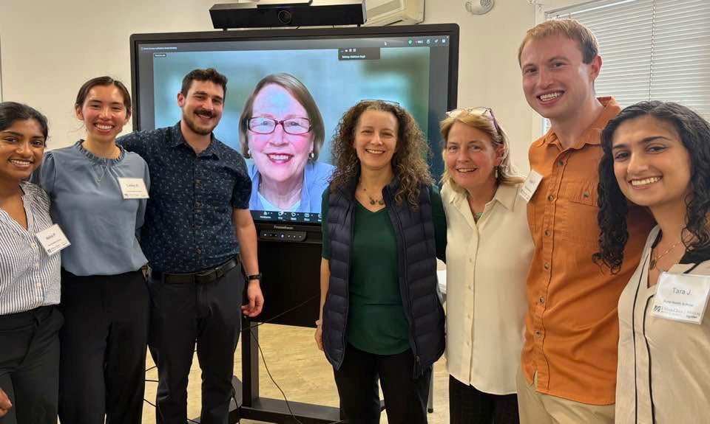
2026 Dukes County Health Council
Rural Health Scholars Program
In 2026 Dukes County Health and Human Services Department was the sponsor of the 2026 project.
In April 2026 UMass Chan medical students focused on mapping out the continuum of care and barriers to collaboration among health and other social service providers on Martha’s Vineyard.

Slide 20
Trend in client service

Slide 21

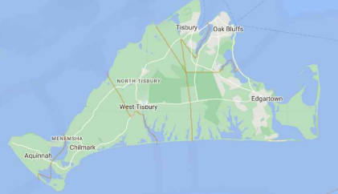
Island-wide Agreement
The Intermunicipal Agreement (IMA) between all six towns and Dukes County, ensuring ongoing funding for Health Care Access and Public Benefits Access.
  The IMA outlines:
    Governance structure
    County’s role and services provided
    Town obligations
    Municipal Membership Assessments
    Indemnification and Insurance

Slide 22
Funding
FY2026 Town Funding: $653,854
FY2026 funding from other sources: $219,997
  Island Health Care via US Health Services Resources Administration
  Massachusetts Health Connector Authority
  Martha’s Vineyard Hospital
  Community Action Committee of Cape and Islands
  DTA SNAP Outreach Program via UMass
  South Shore Community Action Committee
Local business & individual donors for client support $27K & dental program: $23,750

Slide 23
Program and staff information
Interim Director of HHS (FY26) – Sarah Kuh
skuh@dukescounty.gov
Incoming Director of HHS (FY27) – Rocy Turner director.hhs@dukescounty.gov
Health Access Specialists:
Maria Mouzinho, Nikole Rolston, Brianna Bertoni, Sarah Kuh
Public Benefits Caseworker
Wendy Maseda publicbenefits@dukescounty.gov
Administrative Assistant
(FY26 Ronelle Couture)
hca@dukescounty.gov

Slide 24
Program and staff information
Telephone: (508)-696-0020
Email: hca@dukescounty.gov
Website: www.dukescounty.gov
Fax: (508)-696-7352
HCA main office site: 114 New York Ave, Oak Bluffs
PBA office site: 9 Airport Road, Edgartown, MA 02539

